Slide 1


London Road and West Access
Group 2
Photograph by Amelia Hatfield
BPLN0105 Transport Consultancy Study
Presented by Amelia Hatfield, Jana El Hajj, Guanhua Zhao and Jemma Richmond
Notes:
Good day everyone,​
​
We’re group 2 and are going to talk about how to improve the London Road and the West Access to Hilsea Lines.

Slide 2
Contents
01
Baseline
02
Our Vision
03
Quick Wins
04
Proposals
Study Area
Area Groups
User Groups
Project Vision
Quick Win Map
General Components
Package 1
Package 2
Package 3
Multi-Criteria Analysis
Notes:
This is our table of contents

Slide 3
Baseline Investigation
Photograph by Amelia Hatfield

Slide 4
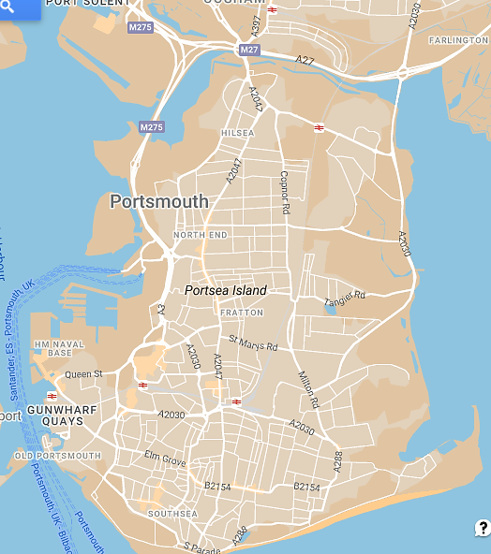
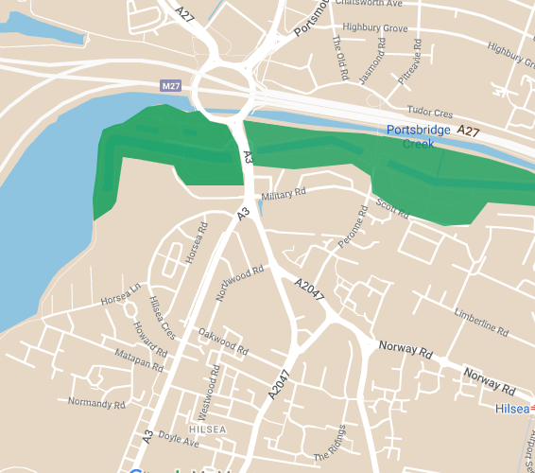
Site located below major intersection to motorway
Hilsea Lido – already has some regeneration
Hillsea Lines – focus area of upgrades
Project scope
Mainly residential area
With general lack of access to green space and appropriate infrastructure
BRIEF Addressing issues of severance and blight,
Improving access to the site from the west,
Improving longer distance connections to the site,
Enhance green infrastructure. ​
Study Area
Map from Google my maps
Notes:
To begin with, our study area is located below…
And to the west, is the Lido..
And to the east, is Hilsea Lines..
The scope is
addressing … from the busy London Road,
thereby improving .. [Both from the Hilsea Lido interchange and Portsmouth Park & Ride, ]
And in parallel, enhancing…
As for our study area, it’s primarily a residential area that suffers from a general…
Time:1min

Slide 5
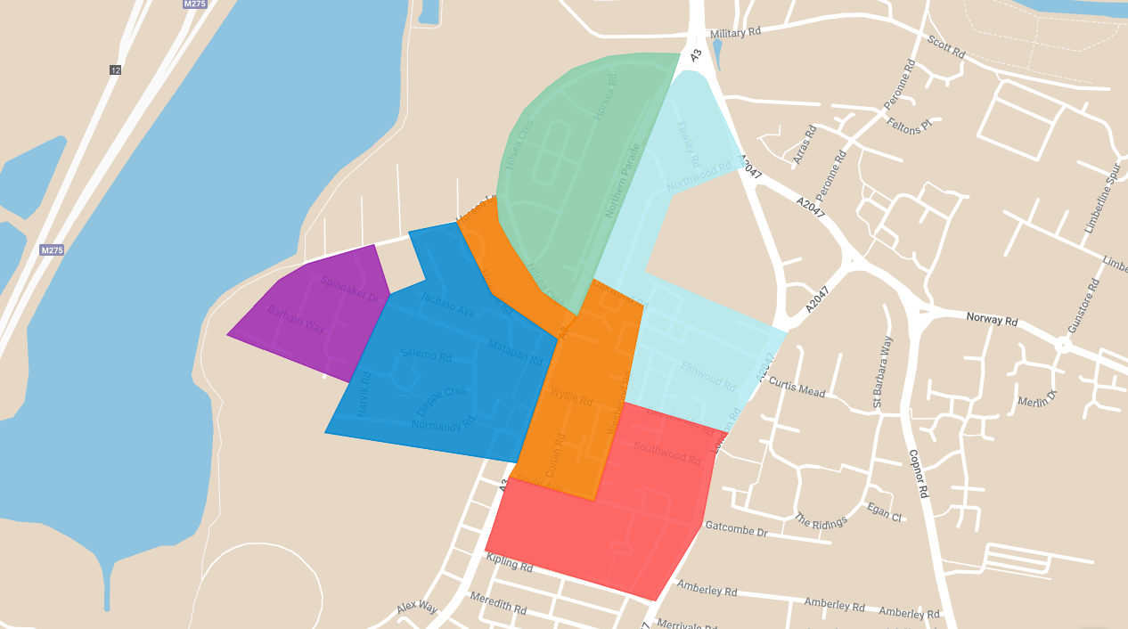
Area 1
48-54% women
19% children, 12% elderly
16% immigrants
40% no employment
Terraced mixed use, stable household
People on a budget
Area 4
47-54% women
Approx 19% children, 12% elderly
16% immigrants
Cosmopolitan family
Area 2
54-94% women
Approx. 19% children, 12% elderly
16% immigrants
Medium-low levels of disability
Terraced mixed use, stable household
Area 5 – Most Vulnerable
54-94% women
Approx 19% children, 12% elderly
16% immigrants
Highest level of disability
50% users do not have car
52% no employment
Disadvantaged single household
Largest number of elderly people
Vulnerable Pensioner
Area 3
48-54% women
Approx 19% children, 12% elderly
16% immigrants
Highest area of bus use to work 11% and bicycle 7%
Largest number of young children 9%
Area 6
47-50% women
Approx 19% children, 12% elderly
16% immigrants
Baseline Evaluation
Area Groups
(Map from Google my maps; CDRC MapMaker, 2011; DataShine, 2011)
Notes:
So Moving on, let’s have a closer look at the demographics.
The entire area has been divided into six parts based on LSOA. and All areas share a similar proportion of women, elderly people, children, and immigrants.
However, Area 1 is characterized by terraced mixed-use and stable households, with a budget-conscious population. While Area 2 has a medium-low levels of disability.
Area 3 has the highest public transport and bicycle usage proportion, 11% and 7% respectively.
And Area 4, which mostly consists of cosmopolitan families, has the highest median house price, making it more likely for residents to own cars and be our aim to do the mode shift
Lastly，Area 5 has been identified as the most vulnerable, with a 52% unemployment rate and the highest level of disability. Moreover, half of the residents here are car-free. And the main family structure is disadvantaged single households with many vulnerable pensioners.
Therefore, residents in this area are most likely to be pedestrians and currently rely on buses, which may cause a significant need for pedestrian infrastructure.
Time: 2min20s
54-94% women
Approx. 19% children, 12% elderly
16% immigrants
Medium-low levels of disability
Terraced mixed use, stable household

Slide 6
 | ​ | Spatial Barriers​ |  |  |  | Temporal​ Barriers |  |  | Financial Barriers​ |  | ​
 | Feature​ | Pedestrian Bridges​ | Bus Stop​ | Road​ | Bus Services​ | Seasonal​ | Time of day​ | Bus Services​ | Historic investment / policy focus​ | Externalities​ | Total of 45
 |  | Noisy, steep, stairs ​​ | Poor facilities​ | Fast, Car-centric​ | ​Poor connectivity​​ | Exposure to wind, rain​​ | Poor Lighting​​ | ​Poor Timetabling​ Info | Car-centric​ | time, safety, comfort​​
Demographic Groups (based on Kuttler and Moraglio, 2021) | Visually Impaired​​ | 5 | 5 | 5 | 4 | 4 | 5 | 5 | 3 | 5 | 41
 | Difficulty hearing​​ | 3 | 5 | 4 | 4 | 4 | 4 | 5 | 3 | 5 | 37
 | Mobility Impaired​​ | 5 | 5 | 4 | 5 | 4 | 4 | 5 | 3 | 5 | 40
 | Parents (single)​ | 3 | 3 | 5 | 3 | 4 | 4 | 3 | 3 | 4 | 32
 | Elderly ​​ | 5 | 4 | 4 | 4 | 4 | 5 | 3 | 3 | 4 | 36
 | Children​, youth​ | 1 | 4 | 5 | 4 | 4 | 5 | 3 | 5 | 5 | 36
 | Women ​​ | 4 | 4 | 2 | 3 | 3 | 5 | 5 | 2 | 3 | 31
 | Low income​ | 2 | 3 | 4 | 4 | 4 | 4 | 4 | 4 | 5 | 34
Mobility Groups | Bus users ​​ | 3 | 4 | 3 | 5 | 5 | 4 | 5 | 5 | 4 | 38
 | Pedestrians ​​ | 3 | 3 | 5 | 4 | 5 | 5 | 3 | 5 | 5 | 38
 | Cyclists ​​ | 4 | 3 | 5 | 1 | 5 | 5 | 3 | 5 | 5 | 36
 | Car users​​ | 0 | 0 | 0 | 0 | 0 | 3 | 0 | 0 | 0 | 3
*Likert Scale 0 = no impact; 5 = severe impacts
Baseline Evaluation
User Groups
Notes:
Analysis of the impacts of different barriers on different groups.
Briefly explain the barriers
How the groups came
Limitation: does not consider intersecting identities and disadvantages such as a single parent who is a women etc...

Slide 7
Vision
Photograph by Amelia Hatfield

Slide 8
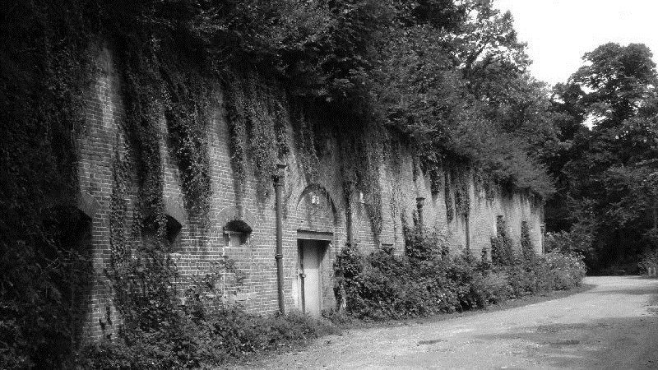
OUR VISION
“To create a thriving, liveable area where local culture, local business, nature and clean air are accessible to all, and mental and physical health and wellbeing are improved through access to green infrastructure and sustainable travel options.”
Notes:
Based on:
Policy review: pulled out key themes which informed vision
Portsmouth Transport Strategy 2021-2038 LTP4
Portsmouth Air Quality Strategy, 2017-2027:,
Local Cycling and Walking Infrastructure Plan 2020-2030 by Portsmouth City Council. (LCWIP),
A City to Share published by Portsmouth Cycling Campaign and adopted by the City Council:
Economic development and regeneration strategy: ,
Portsmouth Tourism and Visitor Economy Strategy:,
Waltham Forest Mini Holland Design Guide,
Imagine Portsmouth 2040,

Slide 9
Quick Wins
Photograph by Amelia Hatfield
Timeline of Implementation: Twelve months

Slide 10
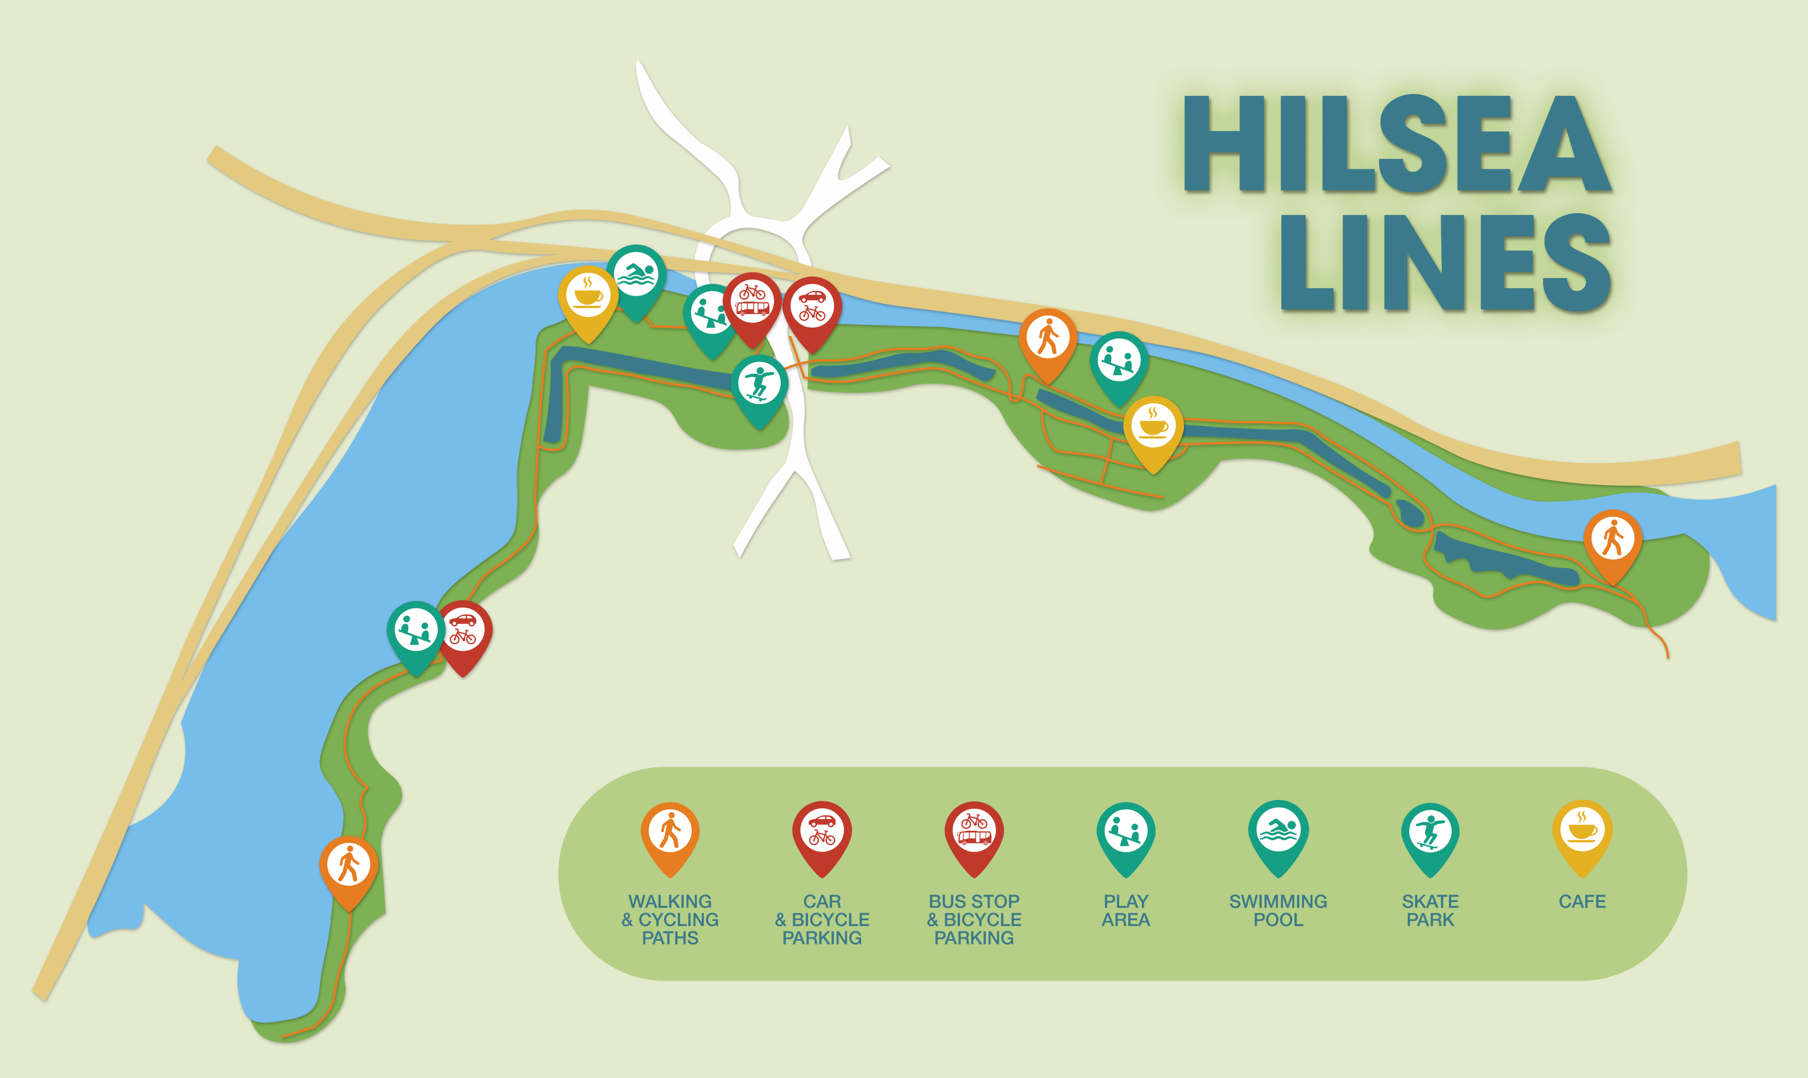

01
Severance
02
Bus Stop
CONCRETE BRIDGE
ROAD SPEED
03
Greenway
04
Long distance connection
Park map created by Cara Richmond
Park map created by Cara Richmond
Notes:
Out short term solutions cover four main themes. The first aims to reduce the severance created by London road. This will be done by adding cosmetic and safety based upgrades to the current pedestrian bridge and reducing the speeds on the road. These will including lighting and greening and reduce pollution and promote use of the crossing.
The second area to cover is to improve the bus stop found on London road. We want to focus this on making the space more appealing, comfortable, accessible and sustainable by making additions such as real time information boards and green roofing. This will make the space more comfortable and accessible to those already relying on it and promote new bus users to come into the area.
Thirdly we want to develop Hilsea lines to be a continuous and holistic greenway that extends across the area shown above. This would connect existing walkways and greenspace. This image give an idea of what a park map for the area could look like. The upgrades would mainly consist of improved wayfinding and adding activities to the route.
And finally we want to improve connectivity to the surrounding areas. We will also add cycle parking and cycle routes in line with Portsmouth’s current active travel plans. This would also involve improving routes for disability access such as improving bus stops along the A3 which serve vulnerable communities highlighted in our baseline. In addition we will add disability parking as well as segregate cycle and pedestrian paths.
Severance: Greenery, Sheltering and protection /// Community Art /// Disability Improvements - Based on DfT (2021) /// Lighting and solar panels /// Reduce speed limit on the road with an ETRO /// Remove guardrail from London Road /// CCTV
Blue Bridge: Tactile paving /// Handrails on each side at two different levels /// Lighting
Concrete Bridge: Gradient 12.5/20 just above the maximum (12/20) /// Handrail required
Bus stop: Real time Information /// Accessibility improvements: Accessible sloping, contrasting color benches, stop flag, guard rail, pavement end marking /// Comfort improvements: Lighting, seating, CCTV /// Sustainability: Green roof, solar panels, sheltered and non-conventional cycle parking
Greenway: Quick wins: Improving wayfinding on the existing route leading to Hilsea Lines and signposting to this route in local area /// Segregating cyclists and pedestrians (LTN 1/20) //// Activity trail leading to Hilsea Lines /// Improved resting facilities /// Improved visibility of entrances to Greenway, and by extension Hilsea Lines /// Improved lighting
Longer distance travel Bike-sharing stop: Beryl Bikes /// Cycle hire scheme for greenway /// Segregated cycle lanes //// Cycle facilities map /// Cycle parking /// coastal entrance, bus stop, car parks /// Electric car and disabled parking
coastal entrance, car parks

Slide 11
Proposals
Photograph by Amelia Hatfield
Timeline of Implementation: Three years

Slide 12
Fixed Components
Removal of bus parking
Parking upgrades – Add electric charging stations
Segregated cycle lanes (A3 and A2047) - LTN 1/20 compliant
Formalise/maintain speed reduction
Continue pedestrian upgrades from Hilsea Lido to Hilsea Lines
Remove blue bridge
Junction upgrade (A3, A2047)

Slide 13
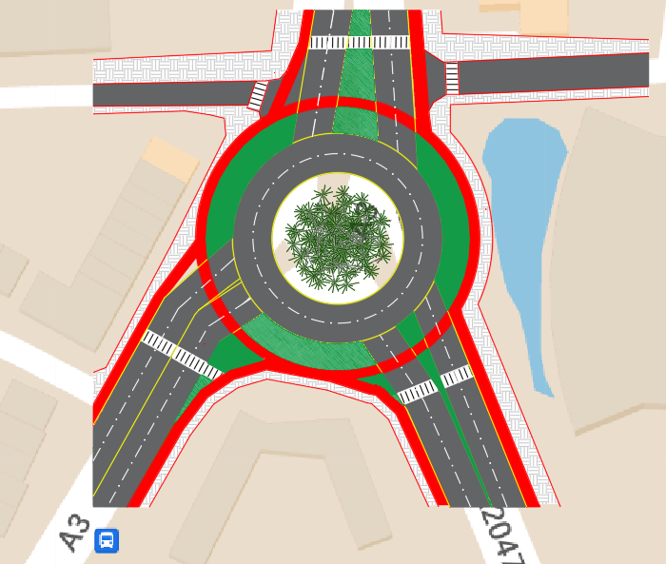
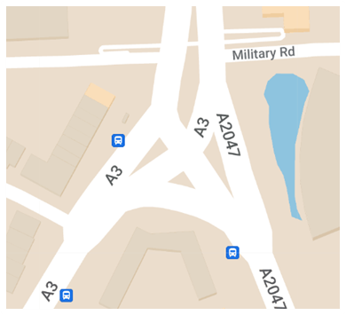
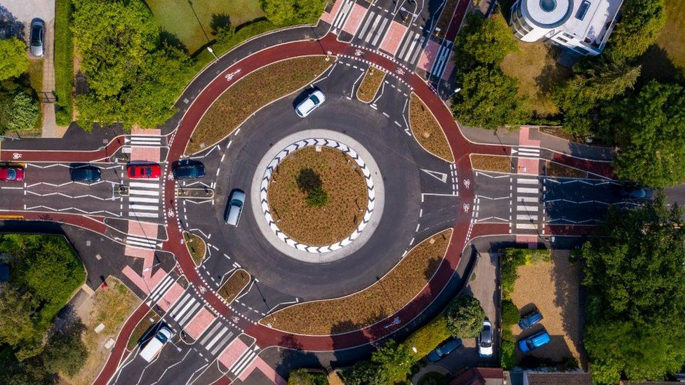
Junction Upgrade Dutch Style Roundabout
Drawing created by Jana El Hajj
Harris (2020)
Map from OpenStreetmaps

Slide 14
Package 1
The park in the sky: This package extends the park so it is a continuous experience not broken by London Road.
Green Continuity
Atrium Studio, No date
Notes:
The first package we have is called Green Continuity.
It involves the construction of a new bridge with small gardens, which we call the "Park in the Sky."
This bridge will connect the Lido and Hilsea Lines, creating a continuous experience that is not broken by London Road.

Slide 15
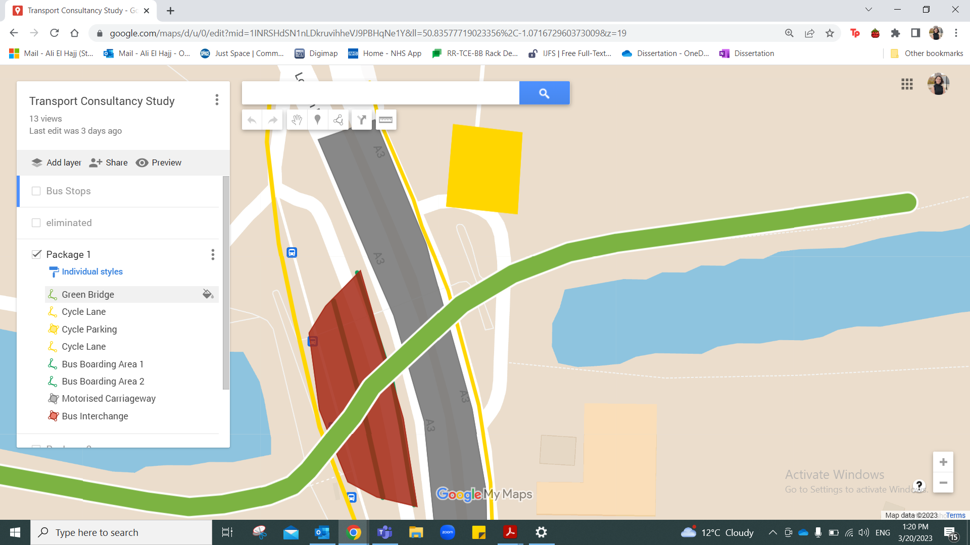
Roadway reduced to 2 lanes per direction.
Widened footways and median
Provision of cycle lanes and cycle Parking
Green Bridge
Width=6m, Length=140m, Gradient=1:20, Clear height=5.7m
Segregated cycle and walkways
Greening, art, resting areas
Universal Accessibility
Connection of the Green Corridor
Bus Interchange:
Two parallel bus stops with overtake lanes
1000m2 Shelter Area
370m2 Facilities Area (Tourist info desk, Toilets, Café, RTPI)
Drawing created by Jana El Hajj
PACKAGE 1
Notes:
So this is the top view for package 1.
In this design, we propose to reduce the roadway to 2 lanes per direction and remove the median fence.
The space saved from this change will be used to widen the footway, median and provide cycle lanes and parking.
Then we come to the centerpiece of package 1: the bridge itself.
It measures 140 meters in length, 6 meters in width and serves as a connection of the green corridor.
It has universal accessibility, like be friendly to wheelchair users and cyclists, because of the gradient of 0.05 and lifts on both sides of the road.
Another unique design is the Bus Interchange. Where the Shelter Area will cover 1000 square meters, and the Facilities Area will span 370 square meters with amenities such as Tourist...

Slide 16
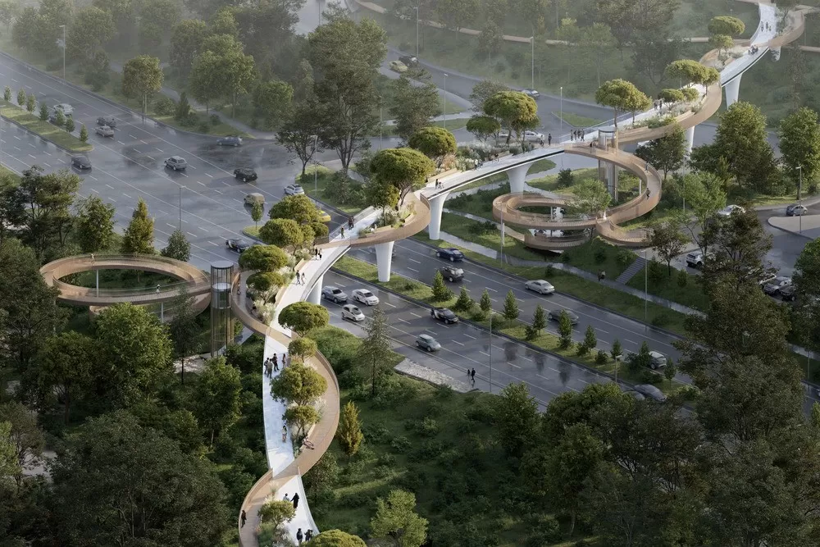
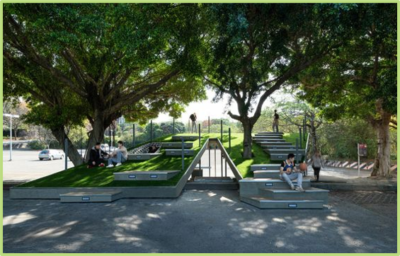
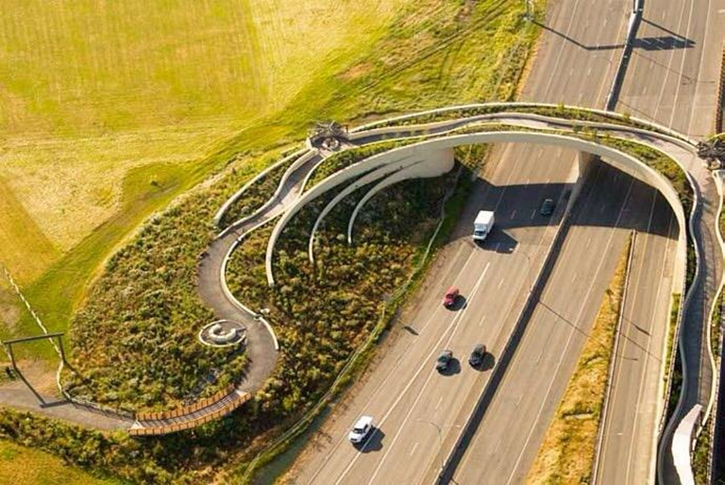
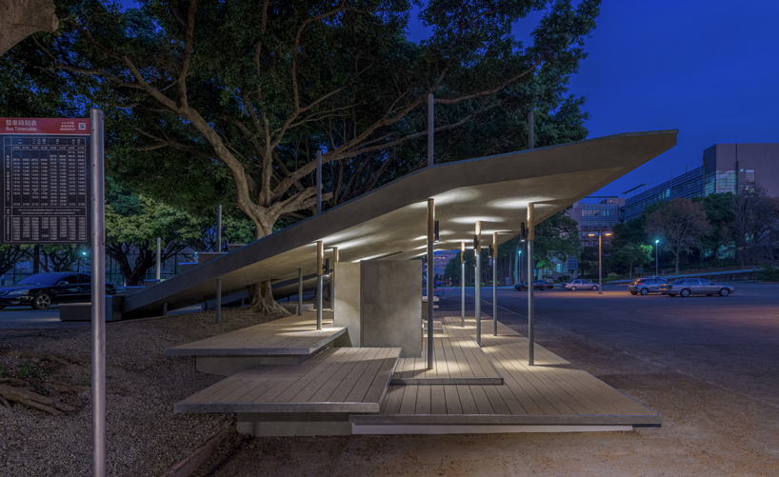
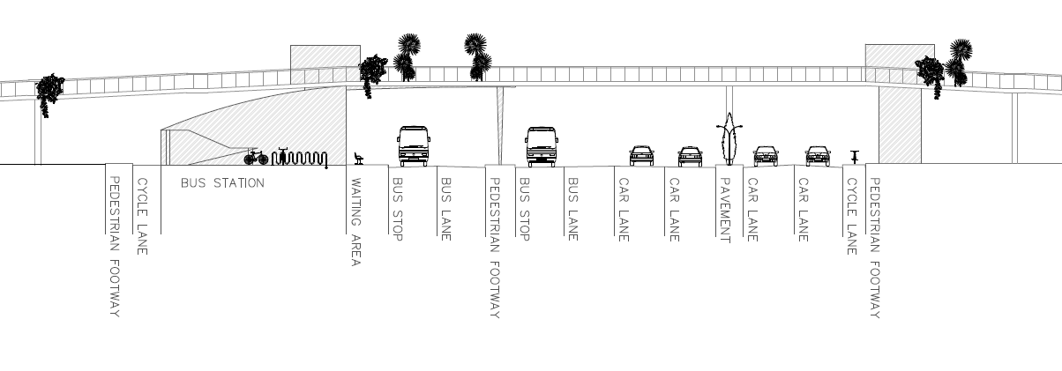
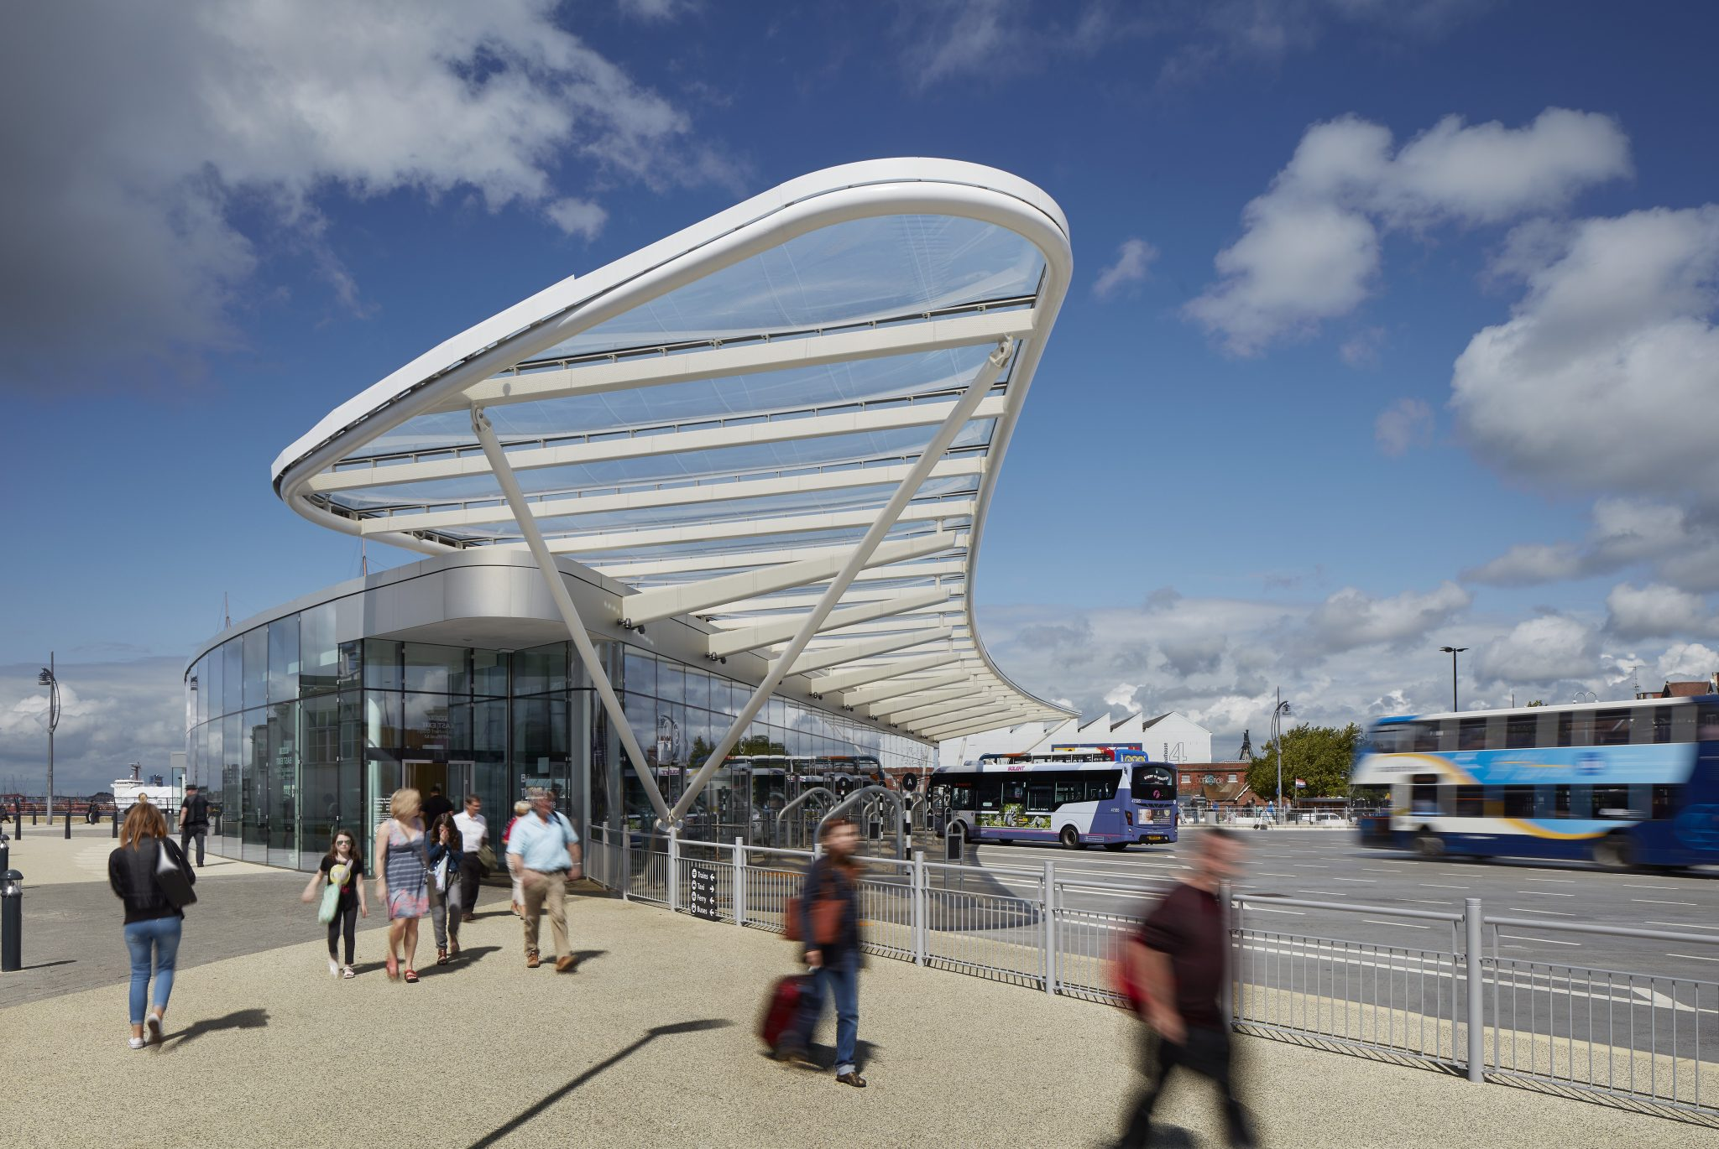
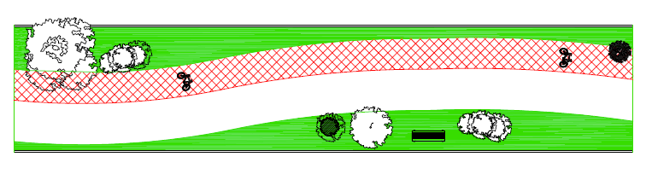
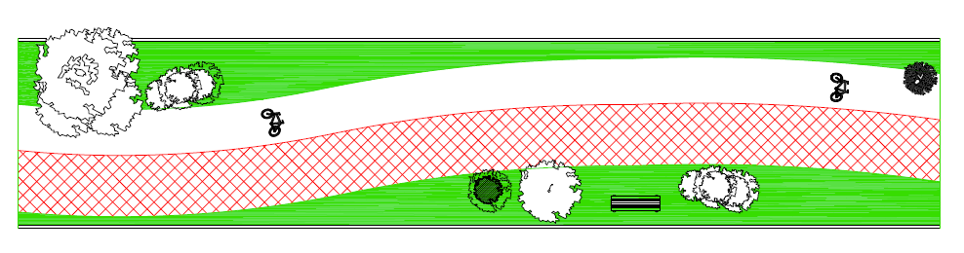
(Designboom, 2020; ROC Consulting, 2023; Inhabitat, 2021; Tripadvisor, 2015; Drawing by Jemma Richmond)
Notes:
To make it clear, we also offer a cross-sectional view with cases.
The first two images are from the NCTU bus stop in Taiwan, China, [designed by CHU STUDIO.]
We want to draw inspiration from the green shelter roof design, which allows people to easily climb and sit, for shade, conversation, and rest, using a series of planks of different heights.
Moreover, solar panels will be installed on the roof to power the station's lighting, which is aligning with our sustainable vision.
The last two images show examples of green bridge.
The image on the right is of the Vancouver Land Bridge in Canada, which use loops to separate pedestrian and relaxation spaces while providing greenery.
And The left one is in Kazakhstan [designed by ATRIUM ]. From the bridge, pedestrians find a hill with an observation deck and community spaces.
[Click]
Inspired by these two designs and with a focus on promoting cycling, the bridge in Package 1 will feature green spaces, artistic features, and resting areas, as well as a separate pathway for bicycles and pedestrians, Which will enable cyclists to travel continuously between Lido and Hilsea Lines without obstruction.
Time: 2min 40s

Slide 17
Package 2
Creation of a transport hub ensuring every person can connect to the greenspace from close or far and easily cross London road.
Mobility for all
[ROC Consultancy, 2023)

Slide 18
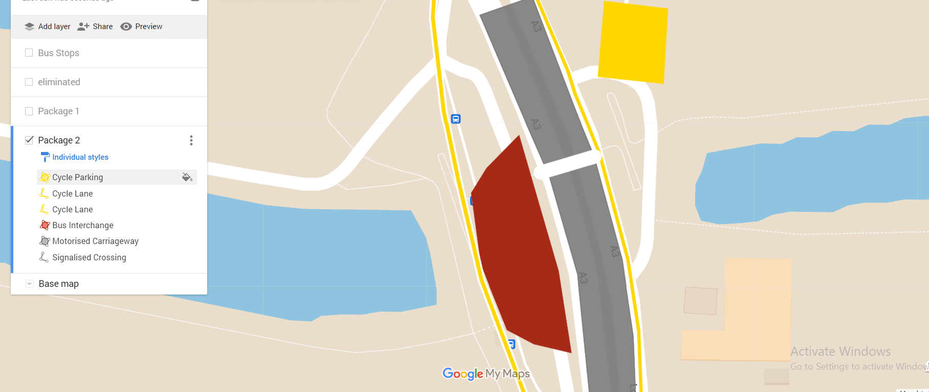
Roadway reduced to 2 lanes per direction
Widened footways
Widen the median and add trees
Provision of cycle lanes and cycle Parking
Interchange:
Two parallel bus stops with overtake lanes
1000m2 Shelter Area
370m2 Facilities Area (Tourist info desk, Toilets, Café, RTPI)
Signalised Crossing
Priority phasing for pedestrians
Audible information
Wide pedestrian island
Raised Toucan crossing
Conveniently aligned with Lido and Hilsea Lines
Drawing created by Jana El Hajj
PACKAGE 2

Slide 19
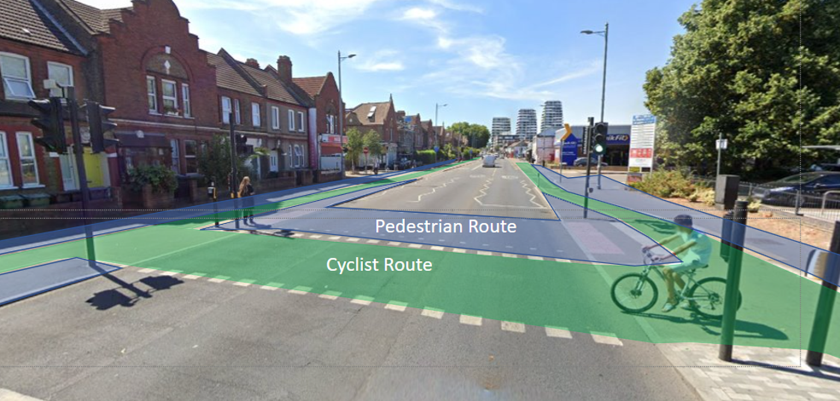
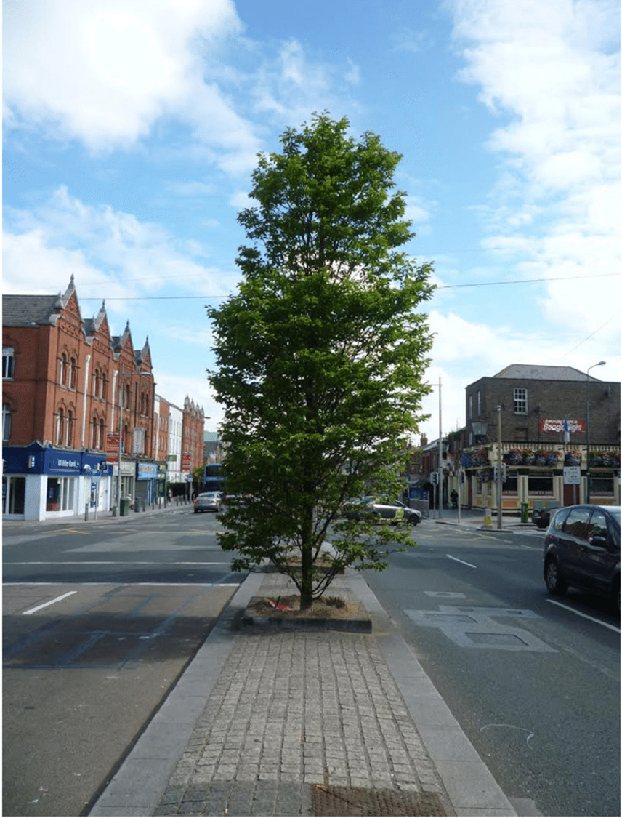
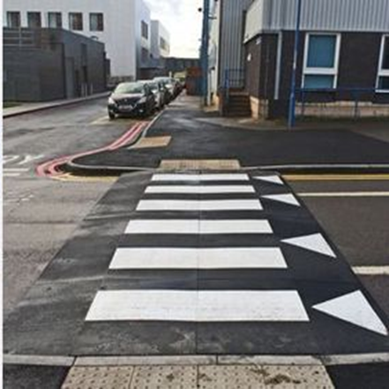
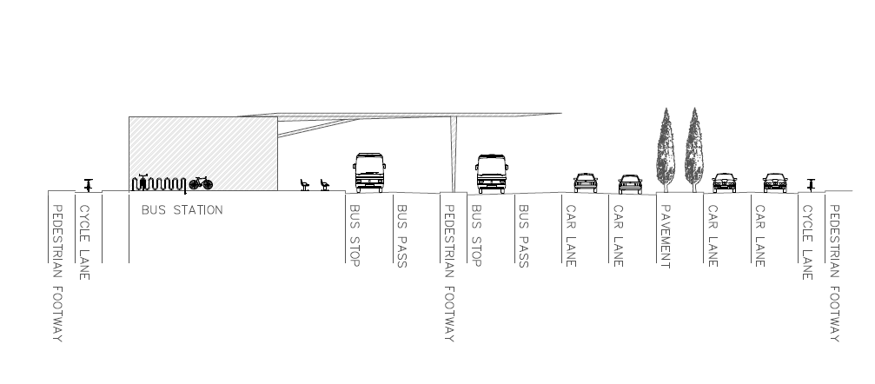
(ROC Consulting, 2023; Rosehill Highways, no date; Google Maps, 2023; Mills et al., 2015; Drawing by Jemma Richmond)
Notes:
Portsmouth Bus Station
Waltham Forest crossing

Slide 20
Package 3
Extending the nearby high-streets using flexible and creative spaces to invite residents and tourists into Hilsea Lines.
People-Centered Space
(Damian Holmes, 2019)
Notes:
**Read the slide
This package will focus on increasing the space available for public realm and improvements will be aimed at opportunities and activities for the community.
The upgrades in this package would align with other initiatives the city is proposing such as those like the Guildhall Walk and continue the cities ambitions supported by the Levelling Up Fund, Future High Streets Fund and Safer Streets Fund

Slide 21
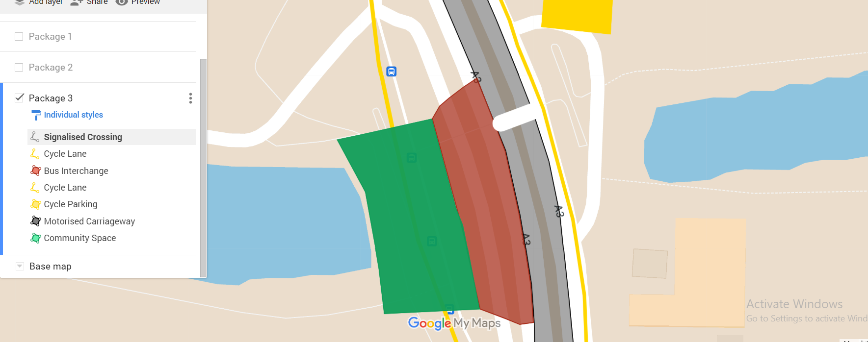
Widened footways
Removal of median
Roadway reduced to 1 lane per direction
Provision of cycle lanes and cycle Parking
Southbound Cycleway segregated by plant lane
Interchange:
One long bus stop with overtake lane
1000m2 Shelter Area
1330m2 Multipurpose Community Space
Signalised Crossing
Priority phasing for pedestrians
Audible information
Raised Toucan crossing
Conveniently aligned with Lido and Hilsea Lines
PACKAGE 3
Drawing created by Jana El Hajj
Notes:
** described coloured area on image. Including size of space
** remember to note crossing

Slide 22
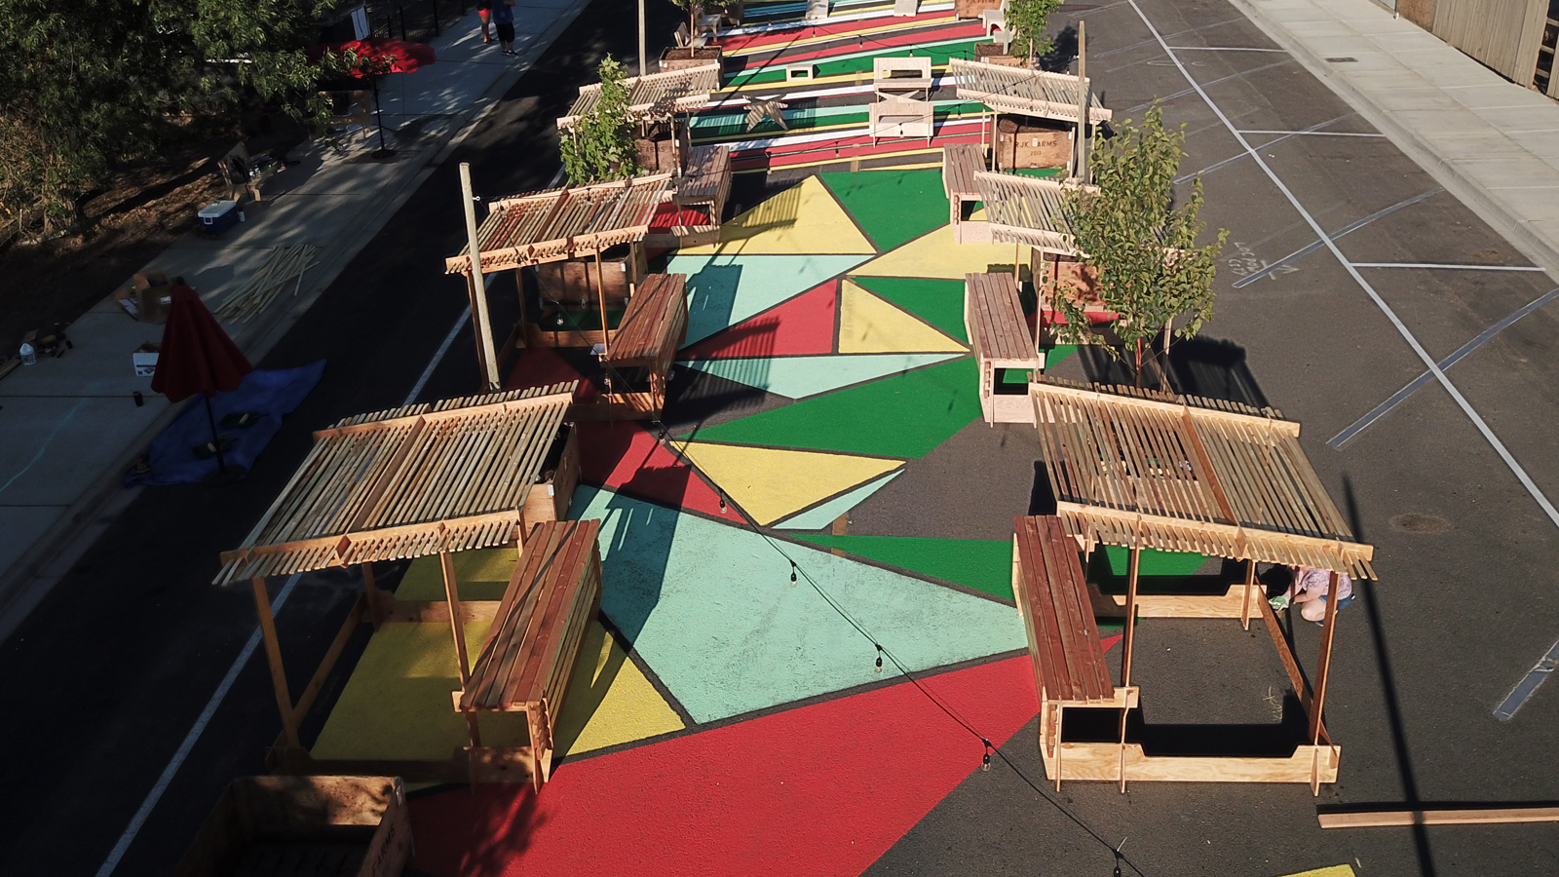
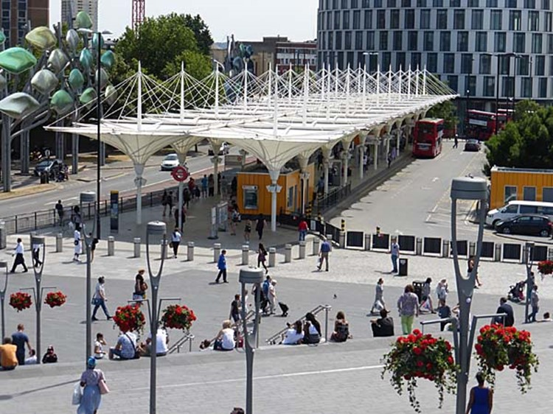
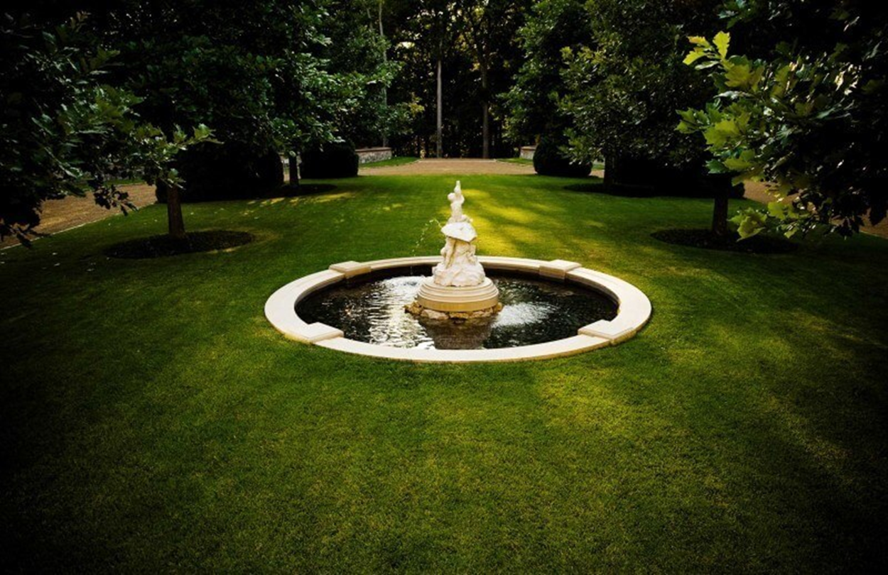
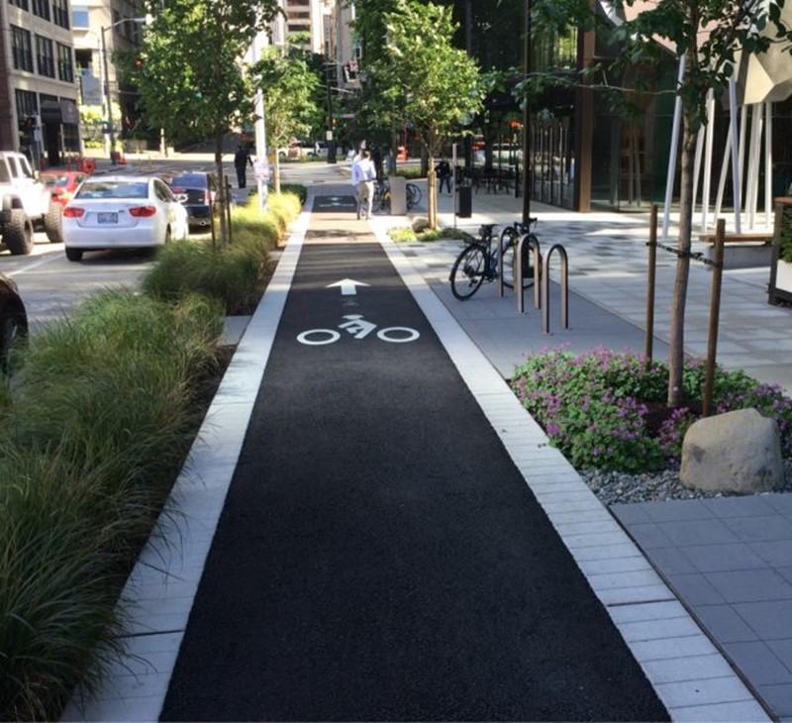
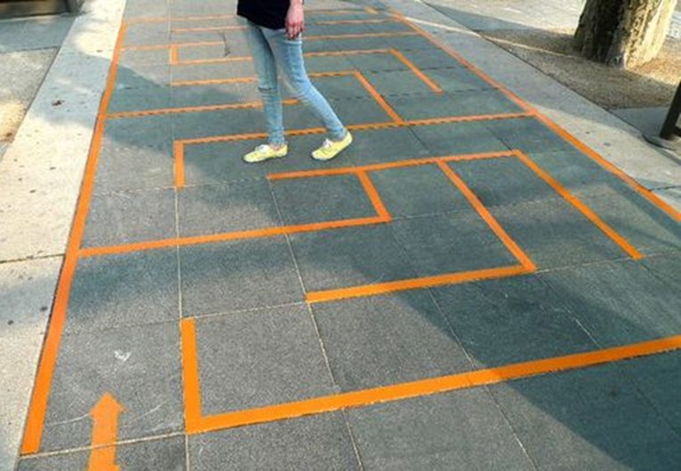
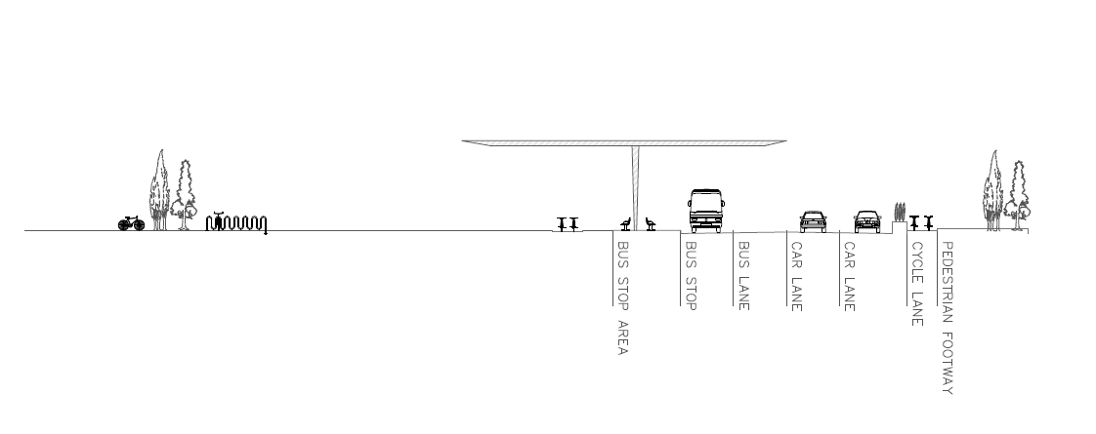
(StyleBlueprint, 2023; Microsoft Local, 2020; Feeldesain, 2011; Simpson, 2023; Maus, 2016; Drawing by Jemma Richmond)
Notes:
** 1 - road cross section
** 2 – Bus Stop
** 3 – community space
This space focuses on creating opportunities for business, art and culture in the area and aims at producing a space that everyone can feel comfortable in and use whether it be children or the elderly. The space should be flexible to fit the communities needs and wants as the arise whether that be a need for activity, music or markets. This space will allow the users to make it their own while still being a part of nature.

Slide 23
Multi-Criteria Analysis
Photograph by Amelia Hatfield

Slide 24
Multi-Criteria Analysis
 |  |  |  | BAU |  | Package 1 |  | Package 2 |  | Package 3
Criteria | Sub- Criteria | What is this measuring? | WEIGHTING | Score | Weighted score | Score | Weighted score | Score | Weighted score | Score | Weighted score
Demographic groups | Mobility impaired | How much does the design improve the experience for these groups? | 10 | -5 | -50 | 3 | 30 | 4 | 40 | 5 | 50
 | Families and children |  | 7 | -3 | -21 | 3 | 21 | 3 | 21 | 5 | 35
 | Women |  | 7 | -2 | -14 | 3 | 21 | 5 | 35 | 4 | 28
 | Low income/deprived |  | 7 | -2 | -14 | 4 | 28 | 3 | 21 | 5 | 35
Transport user groups | Bus users |  | 12 | -3 | -36 | 4 | 48 | 5 | 60 | 3 | 36
 | Pedestrians |  | 12 | -4 | -48 | 4 | 48 | 4 | 48 | 5 | 60
 | Cyclists |  | 12 | -5 | -60 | 3 | 36 | 4 | 48 | 5 | 60
Strategic priorities | Air & noise pollution | How much will the design contribute to improved air quality? | 10 | -5 | -50 | 3 | 30 | 3 | 30 | 4 | 40
 | Green space | How much will access to green space be improved by this design? Including creation of new green spaces | 9 | 0 | 0 | 5 | 45 | 3 | 27 | 4 | 36
 | Improved public realm | How much will the design contribute to improving the public realm? | 6 | -1 | -6 | 4 | 24 | 3 | 18 | 5 | 30
 | Improved opportunities for business | How much will the design create new opportunities for businesses? | 8 | -4 | -32 | 3 | 24 | 3 | 24 | 5 | 40
Total |  |  | 100 |  | -331 |  | 355 |  | 372 |  | 450

Slide 25
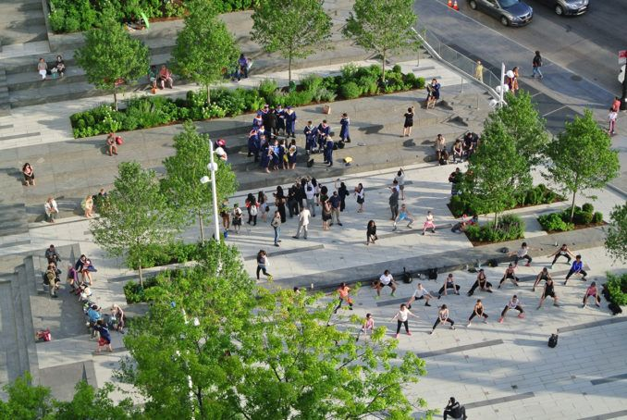
COMMUNITY
ART
LEISURE
ART
FLEXIBLE
FAMILY
PLAY
FOOD
GREEN
BUSINESS
PACKAGE 3
SOCIAL
Sometimes serving the community can be more influential than an iconic structure. Ultimately ensuring access for all was essential in appraising this project.
MARKET
CHILDREN
ACTIVITY
INCLUSIVE
MOBILITY
VIBRANT
DIVERSE
DIVERSE
SHOP
SHOP
PEOPLE
LIVABLE
CONNECTED
SUSTAINABLE

Slide 26
Reference List
Photograph by Amelia Hatfield
Atrium studio (no date) ‘The Bridge in Kazakh’, ABE. Available at https://label-magazine.com/en/architecture/articles/most-po-kazachsku [Accessed 15 March 2023]
CDRC MapMaker (2011), Aging in Place Classification. Available at https://mapmaker.cdrc.ac.uk/#/ageing-in-place-classification?h=1&lon=-1.073&lat=50.8286&zoom=13.21 [Accessed on 01 March 2023]
DataShine Census (2011) Long term health problem or disability. Available at https://datashine.org.uk/#table=QS303EW&col=QS303EW0002&ramp=RdYlGn&layers=BTTT&zoom=11.92634568918848&lon=-0.1283&lat=51.5254 [Accessed on 01 March 2023]
DataShine Census (2011) Method of Travel to work. Available https://datashine.org.uk/#table=QS303EW&col=QS303EW0002&ramp=RdYlGn&layers=BTTT&zoom=11.92634568918848&lon=-0.1282&lat=51.5254 [Accessed on 01 March 2023]
DataShine Census (2011) Car or Van availability. Available at https://datashine.org.uk/#table=QS303EW&col=QS303EW0002&ramp=RdYlGn&layers=BTTT&zoom=11.92634568918848&lon=-0.1283&lat=51.5254 [Accessed on 01 March 2023]
Department for Transport (2021). Inclusive Mobility: A Guide to Best Practice on Access to Pedestrian and Transport Infrastructure. London: Department for Transport. Available at: https://assets.publishing.service.gov.uk/government/uploads/system/uploads/attachment_data/file/1044542/inclusive-mobility-a-guide-to-best-practice-on-access-to-pedestrian-and-transport-infrastructure.pdf
Designboom. (2020). Sturdy inclined roof supported by slim steel columns tops university bus stop in taiwan. Designboom, 7 September 2020. [Online]. Available at: https://www.designboom.com/architecture/sturdy-inclined-roof-slim-steel-columns-university-bus-stop-taiwan-09-07-2020/ [Accessed 20 March 2023].
Holmes, Damian (2019), ‘Grain Collective Joins WLA as a partner’, WLA. Accessed on https://worldlandscapearchitect.com/welcome-to-grain-collective-our-new-wla-partner/?v=79cba1185463 [Accessed on 15 March 2023]
Feeldesain. (2011). Democratie Creative: Street Art for the People to Play. Feeldesain. [Online]. Available at: https://www.feeldesain.com/democratie-creative-street-art-for-the-people-to-play.html [Accessed 20 March 2023].
G, Colin (2008) ‘Hilsea Lines. Portsmouth’, Subterranean History. Available at http://www.subterraneanhistory.co.uk/2008/08/hilsea-lines-portsmouth.html [Accessed on 15 March 2023]
Google Maps (2023). 310 Lea Bridge Rd. Available at: https://www.google.co.uk/maps/@51.5218141,-0.1257739,18z 310 Lea Bridge Rd - Google Maps(Accessed: 20 March 2023).

Slide 27
Reference List
Photograph by Amelia Hatfield
Harris, T. (2020). Cambridge's Dutch-style roundabout: Why all the fuss? [Photograph]. UK: BBC
Inhabitat. (2021). Pedestrian bridge by ATRIUM will grow trees above highway. Inhabitat, 21 January 2021. [Online]. Available at: https://inhabitat.com/pedestrian-bridge-by-atrium-will-grow-trees-above-highway/ [Accessed 20 March 2023].
Kuttler, T., and Moraglio, M. (2021). Re-thinking Mobility Poverty: Understanding Users' Geographies, Backgrounds and Aptitudes. [online]. London: Routledge. Available from: https://doi.org/10.4324/9780367333317. (Accessed 19 February 2023).
Maus, J. (2016). Here’s what Portland’s new carfree street and elevated bikeway will look like. BikePortland.org. [Online]. Available at: https://bikeportland.org/2016/08/04/heres-what-portlands-new-carfree-street-and-elevated-bikeway-will-look-like-188932 [Accessed 20 March 2023].
Microsoft Local. (2020). Creating Multi-Use Community Gathering Spaces in Quincy, Washington. Microsoft Local Blog. [Online]. Available at: https://local.microsoft.com/zh/blog/creating-multi-use-community-gathering-spaces-in-quincy-washington/ [Accessed 20 March 2023].
Mills, G. et al. (2015) “The green ‘signature’ of Irish cities: An examination of the ecosystem services provided by trees using i-Tree Canopy software,” Irish Geography, 48(2), pp. 62–77. Available at: https://doi.org/10.2014/igj.v48i2.625.
Portsmouth City Council. (2021). Portsmouth Transport Strategy 2021-2038. Available at: https://www.portsmouth.gov.uk/wp-content/uploads/2021/11/74.633-Local-Transport-Plan-2021-Final-Accessible.pdf. (Accessed on 1 February 2023).
Portsmouth City Council. (2020). Local Cycling and Walking Infrastructure Plan 2020-2030. Available at: https://travel.portsmouth.gov.uk/wp-content/uploads/2020/09/74.463-LCWIP-Plan.pdf. (Accessed on 1 February 2023).
Portsmouth City Council. (2017). Air Quality Strategy 2017-2027. Available at: https://www.portsmouth.gov.uk/wp-content/uploads/2020/04/env-air-quality-strategy.pdf. (Accessed on 1 February 2023).
ROC Consulting. (2023). Hard Portsmouth Interchange. [Online]. Available at: https://www.rocconsulting.com/projects/hard-portsmouth-interchange/ [Accessed 20 March 2023].
Rosehill Highways. (No date). Raised Tables. Rosehill Highways. [Online]. Available at: https://rosehillhighways.com/products/raised-tables/ [Accessed 20 March 2023].
Simpson, D. (2023). Stratford Bus Station. ManchesterHistory.net. [Online].

